Slide 1

Super Market Sales Analysis
Ahila saseendran

Slide 2
EDA (Exploratory Data Analysis)
Exploratory Data Analysis (EDA) is to summarize the main characteristics of a dataset, often using visual methods. EDA helps identify patterns, trends, and relationships within the data, revealing insights that inform further analysis. It also uncovers anomalies, missing values, and outliers, guiding data cleaning and preparation processes. Ultimately, EDA serves as a critical step in the data analysis workflow, providing a solid foundation for building predictive models or making data-driven decisions.
Dataset Overview
A supermarket sales dataset serves as a vital tool for understanding customer behavior and sales dynamics. It encompasses 17 columns, including key information such as Invoice ID, Date, Time, Branch, City, Customer Type, Gender, Product Line, Unit Price, Quantity, Tax, Gross Income, Gross Percentage, Rating, Total, and Cost of Goods Sold (COGS). Through careful analysis of these components, businesses can pinpoint peak sales periods and assess performance across different branches. The dataset provides insights into purchasing patterns among various customer demographics, helping to identify trends and preferences. Additionally, the exploration of payment methods offers further understanding of consumer choices. By conducting exploratory data analysis (EDA), organizations can make data-driven decisions to optimize inventory management and improve operational efficiency. This analysis enables the tailoring of marketing strategies to better align with customer needs and preferences. Ultimately, these insights contribute to enhancing customer satisfaction and driving profitability. The comprehensive nature of the dataset ensures that stakeholders have the necessary information to strategize effectively and stay competitive in the market.

Slide 3
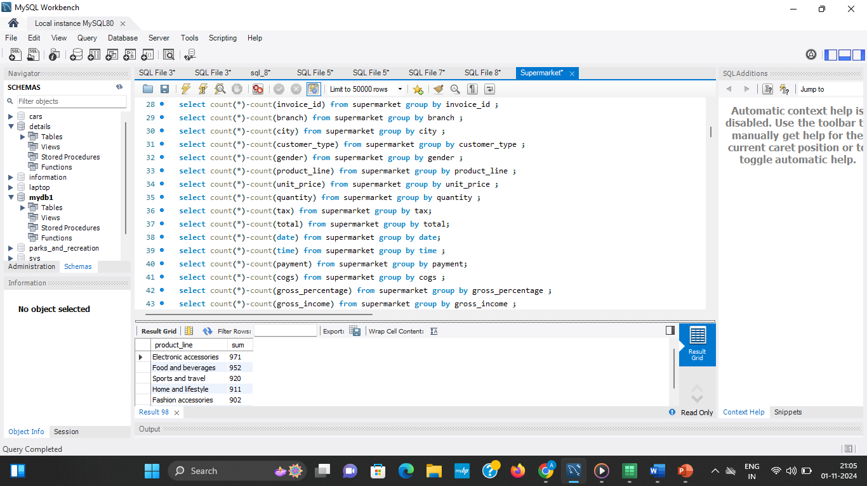
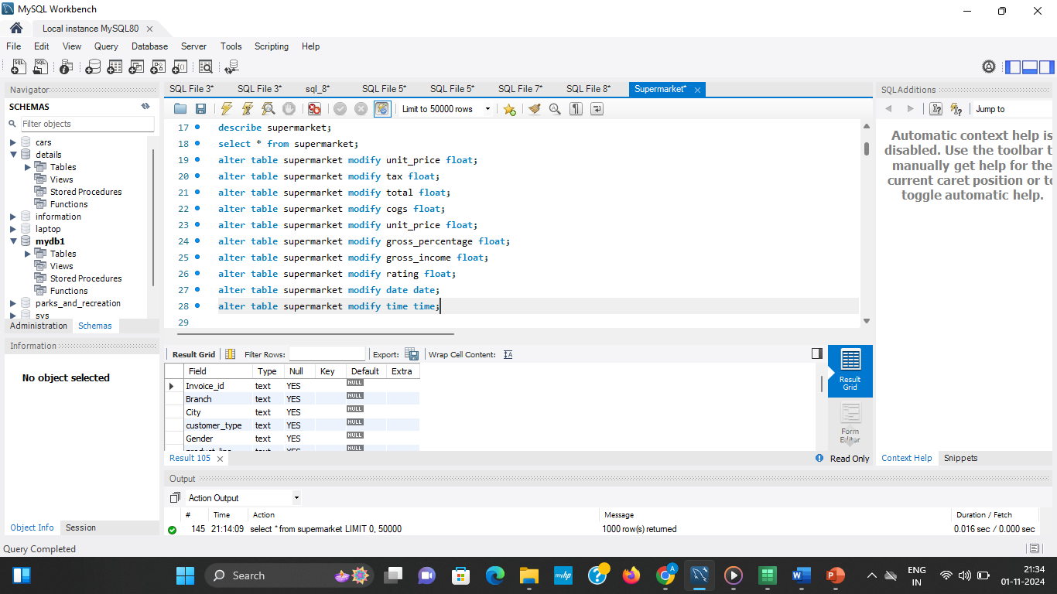
Checking Missing Values
Converting the datatype

Slide 4
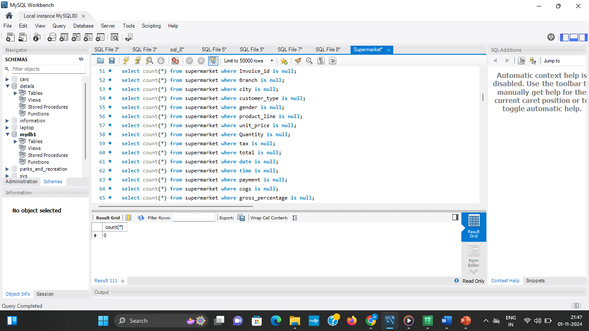
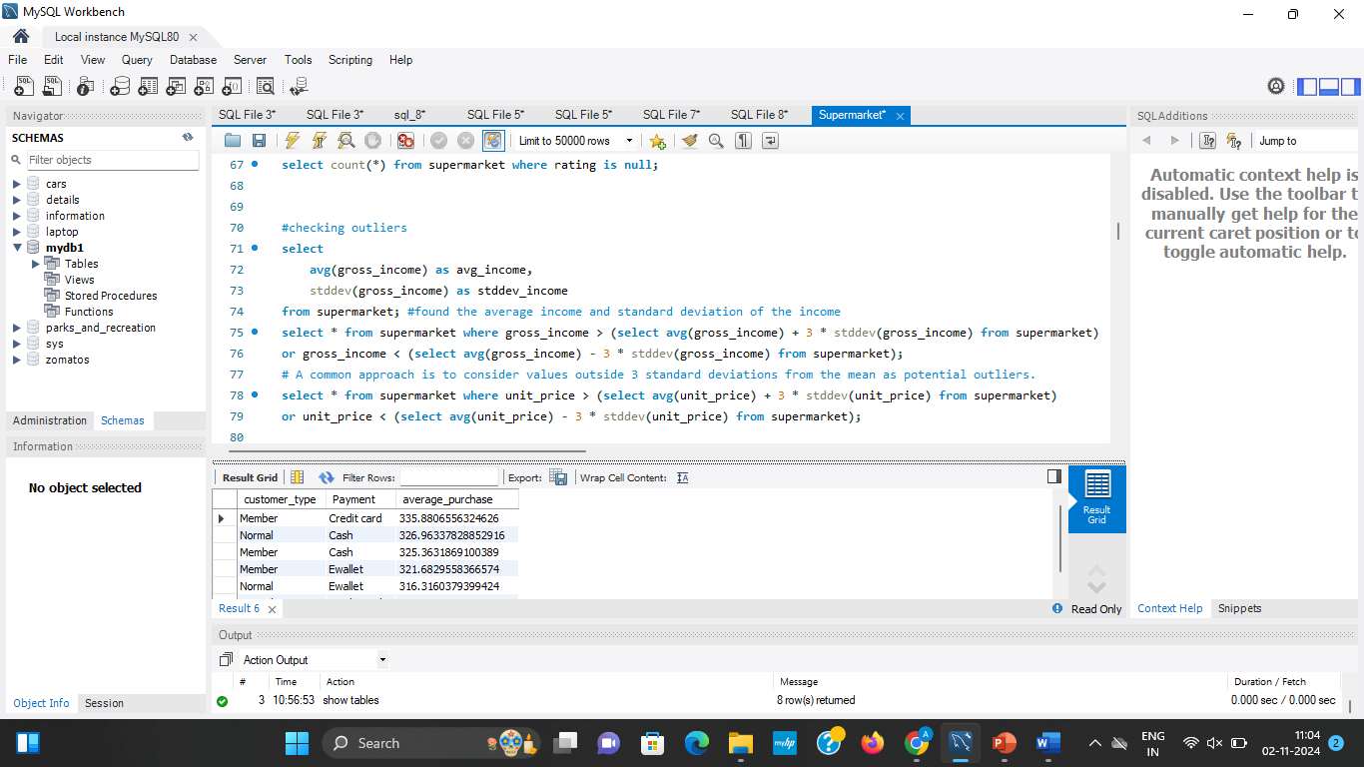
Checking whether there is NULL values
Checking Outliers

Slide 5
Result after cleaning
After the cleaning process, the dataset was prepared for efficient analysis, with minimal noise and enhanced data integrity. This clean and structured data allowed for accurate, insightful multivariate analysis, supporting reliable decision-making and reporting .This clean dataset is now ideal for further exploratory analysis, visualization, and modeling, ensuring meaningful and accurate insights from the SQL EDA.
Checked whether there is any missing values.
Handled Duplicate values.
Fields such as dates, product names, and payment methods may have inconsistent formats ,converted into consistent format
Standardize formats across all records by converting them into a consistent style (e.g., YYYY-MM-DD for dates).
Extreme values may exist in numeric fields (e.g., gross product, quantity) due to data entry errors or genuine anomalies. It was identified and corrected into normal format.
Converted data types to their appropriate formats (e.g., converting text to time or dates in the column time ,date).
Renamed the column to access the column easily.
Ensured proper alignment during data integration, establishing clear data governance rules.
Assessed the relevance of each data field and decide whether to retain, modify, or remove them.
Clarified ambiguous entries through additional data collection or by consulting stakeholders to confirm intended meanings.
Effective data cleaning in a supermarket dataset requires thorough attention to these challenges. By anticipating and addressing these issues

Slide 6
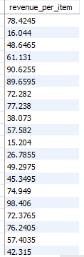
Feature Engineering
Feature engineering is the process of creating new features or transforming existing features to improve model performance or reveal additional insights in exploratory data analysis (EDA).
alter table supermarket add column revenue_per_item float;
update supermarket set revenue_per_item = total / quantity;
Revenue is the total amount of money a business earns from selling its products or services.

Slide 7
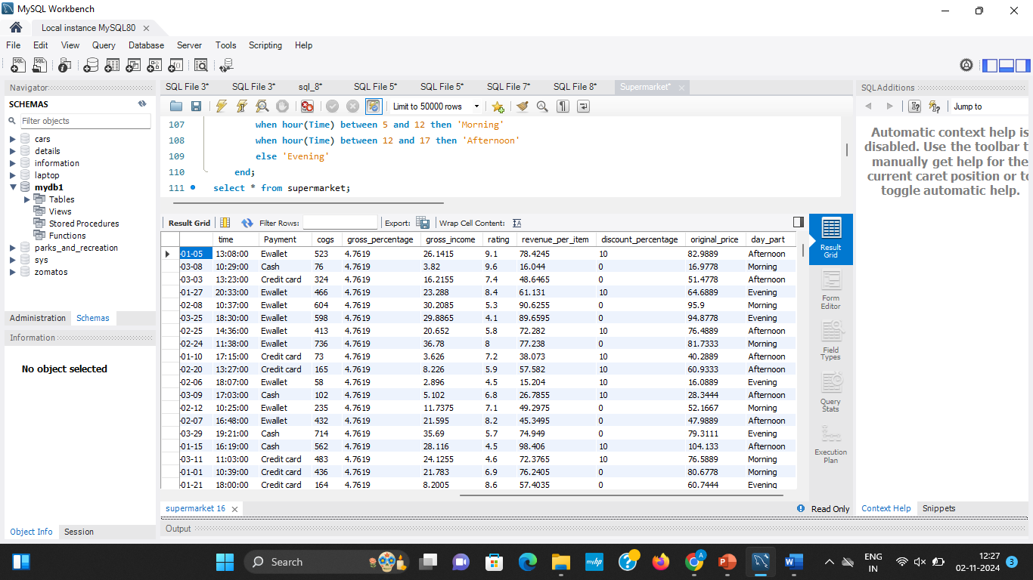
alter table supermarket add column discount_percentage FLOAT;
UPDATE supermarketSET discount_percentage = CASE WHEN customer_type = 'Member' THEN ((original_price - unit_price) / original_price) * 100 ELSE 0 END; #the members are given 10% discount others have no discount
The member is the customer who has membership of the supermarket and is given 10% discount and normal customer has no discount.
alter table supermarket add column original_price FLOAT;
update supermarket set original_price = unit_price / (1 - 0.1);

Slide 8
alter table supermarket add column day_part VARCHAR(10);update supermarket set day_part = case when hour(Time) between 5 and 12 then 'Morning' when hour(Time) between 12 and 17 then 'Afternoon' else 'Evening' end;
Feature engineering is a crucial step in data analysis and machine learning that involves creating new variables (features) from existing data to enhance the performance of models.
The addition of the revenue_per_item column provides a clear view of how much revenue is generated for each item sold. This metric is essential for assessing product profitability and identifying high-performing items.
Introducing the orginal_price column allows for an understanding of how discounts impact sales. The calculation assumes an average discount, enabling the supermarket to analyze pricing strategies and their effectiveness.
The discount_percentage olumn provides a direct measurement of discounts applied to member customers, showcasing the supermarket's loyalty initiatives. By differentiating between member and non-member discounts.
The creation of the day_part column categorizes transactions based on the time of day, allowing for temporal analysis of sales patterns. Understanding peak shopping times (Morning, Afternoon, Evening) helps in optimizing staffing, inventory, and promotional strategies.

Slide 9
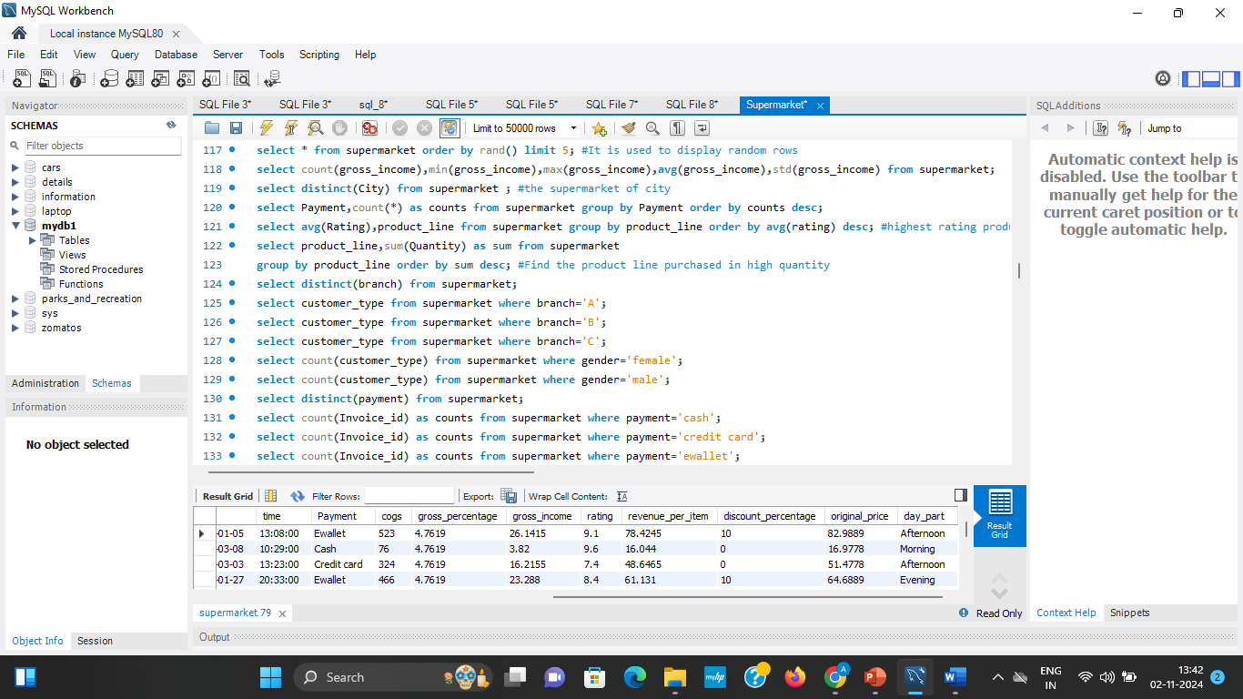
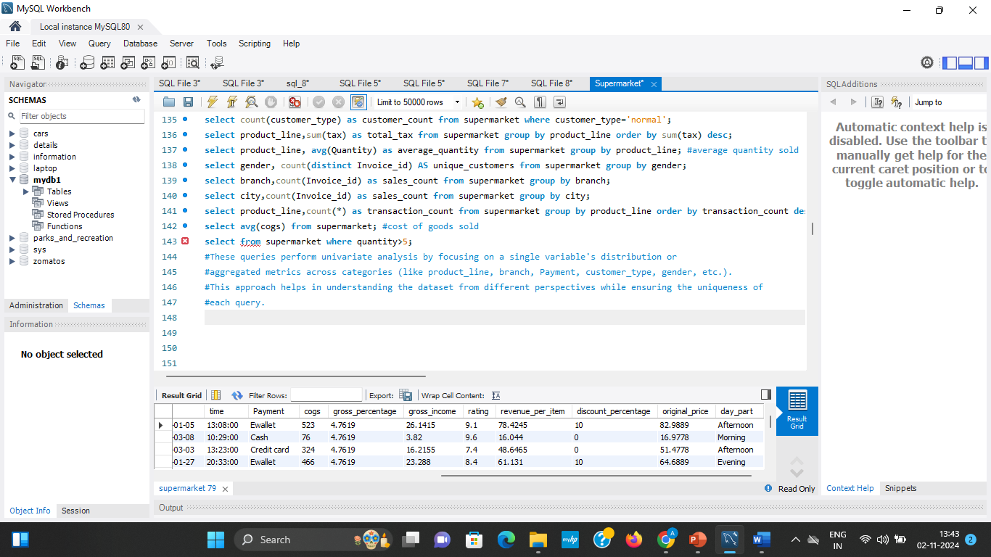
Univariate Analysis
Univariate analysis is a statistical method that focuses on analyzing a single variable at a time. It provides insights into the distribution, central tendency, and dispersion of that variable, which can help in understanding patterns and trends within the data. In the context of supermarket data, univariate analysis can be applied to various columns within the dataset to gain valuable insights.

Slide 10
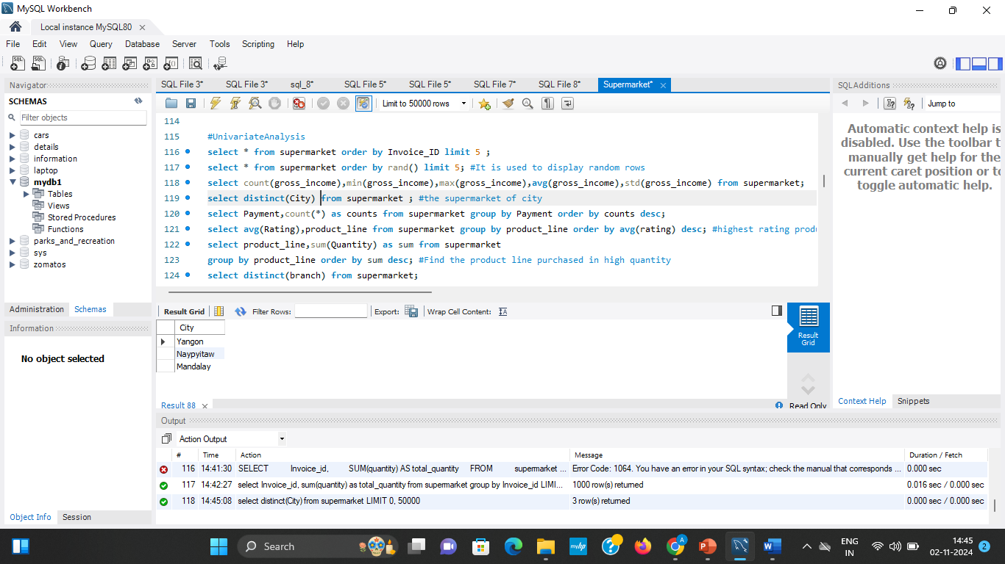
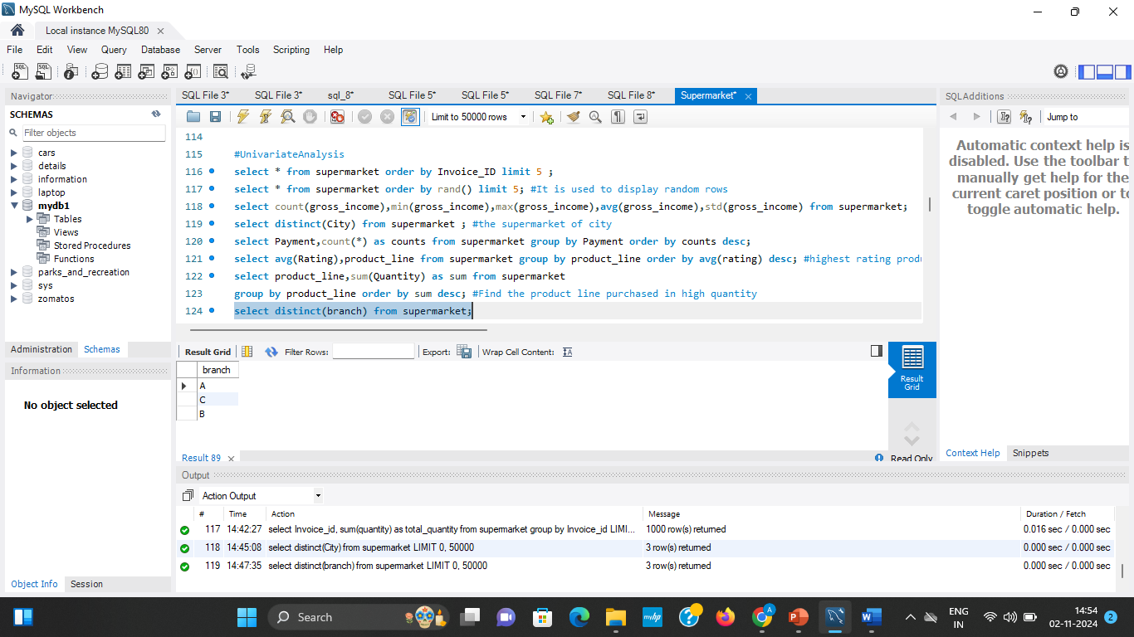
Questions on univariate Analysis
1.In which all city this super market is present ?
select distinct(City) from supermarket ;
2.What are the branches of the super market ?
select distinct(branch) from supermarket;

Slide 11
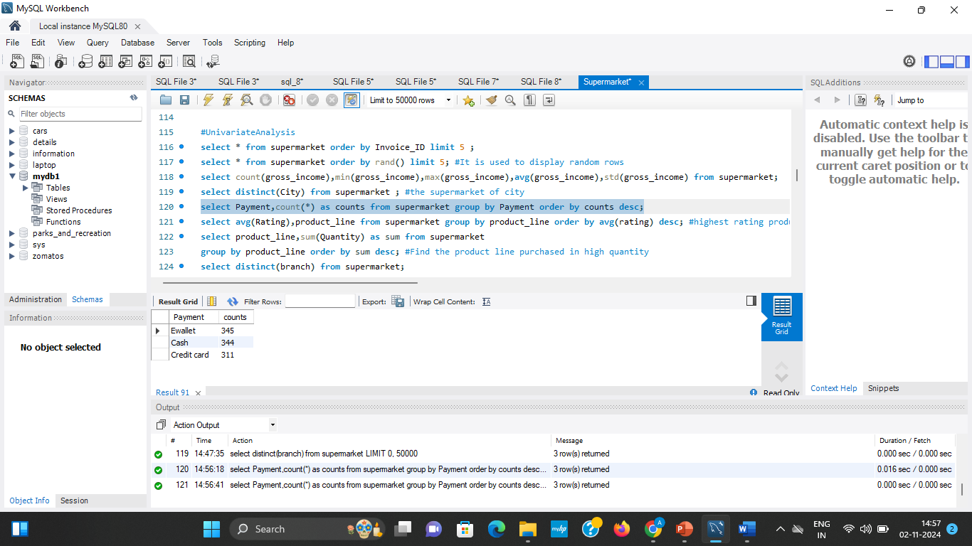
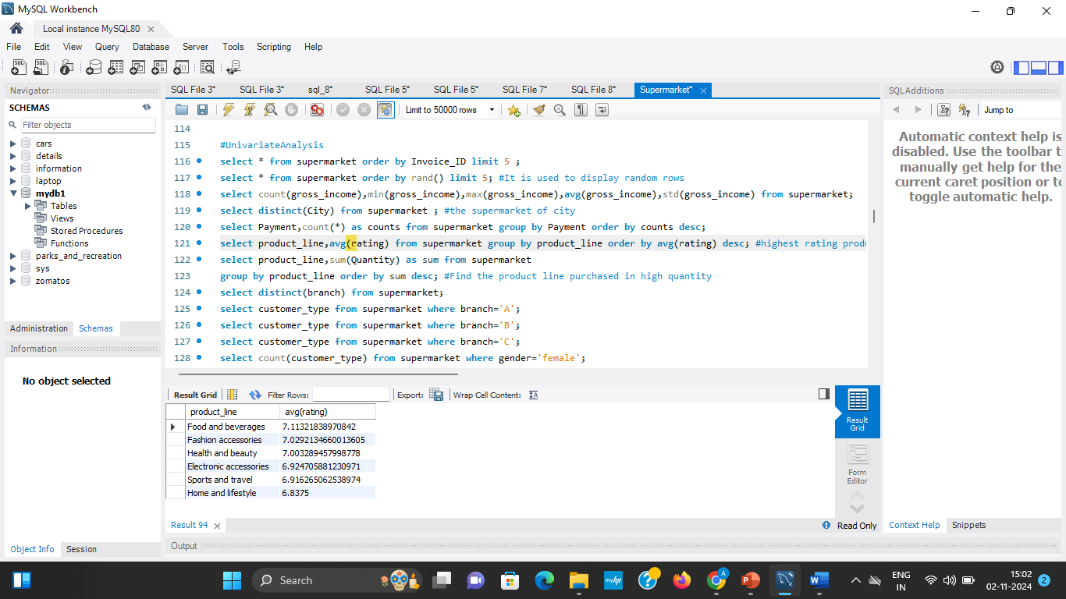
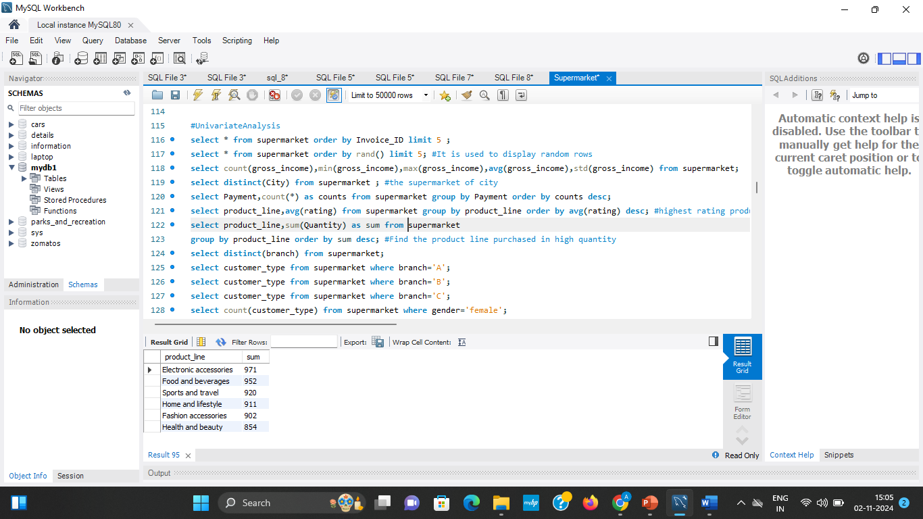
3.Payment mode where customers choose mostly ?
select Payment, count(*) as counts from supermarket group by Payment order by counts desc;
4.What product line have average rating ?
select avg(Rating),product_line from supermarket group by product_line order by avg(rating) desc;
5. Which product line is purchased for highest quantity ?
select product_line,sum(Quantity) as sum from supermarket group by product_line order by sum desc;

Slide 12
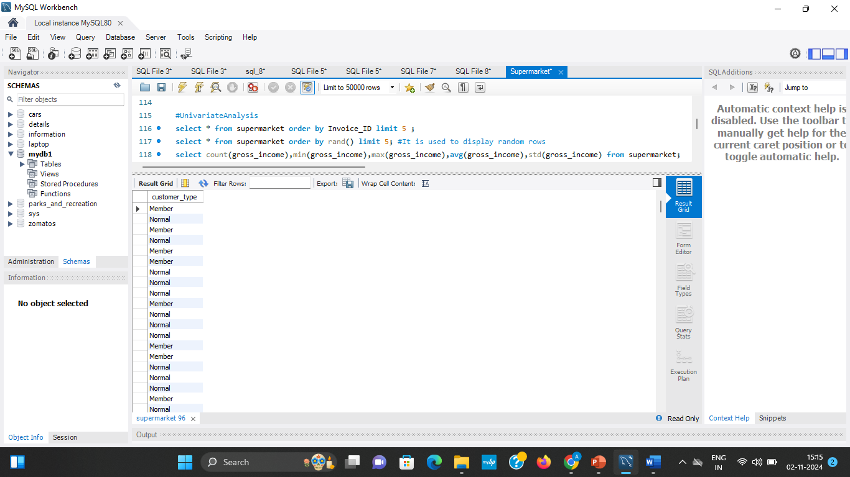
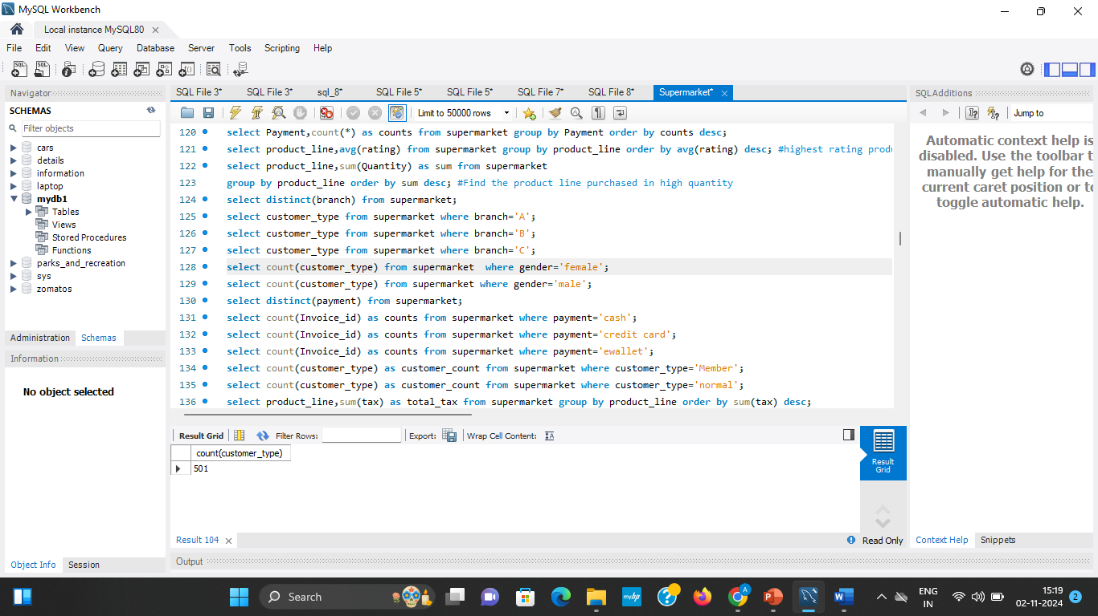

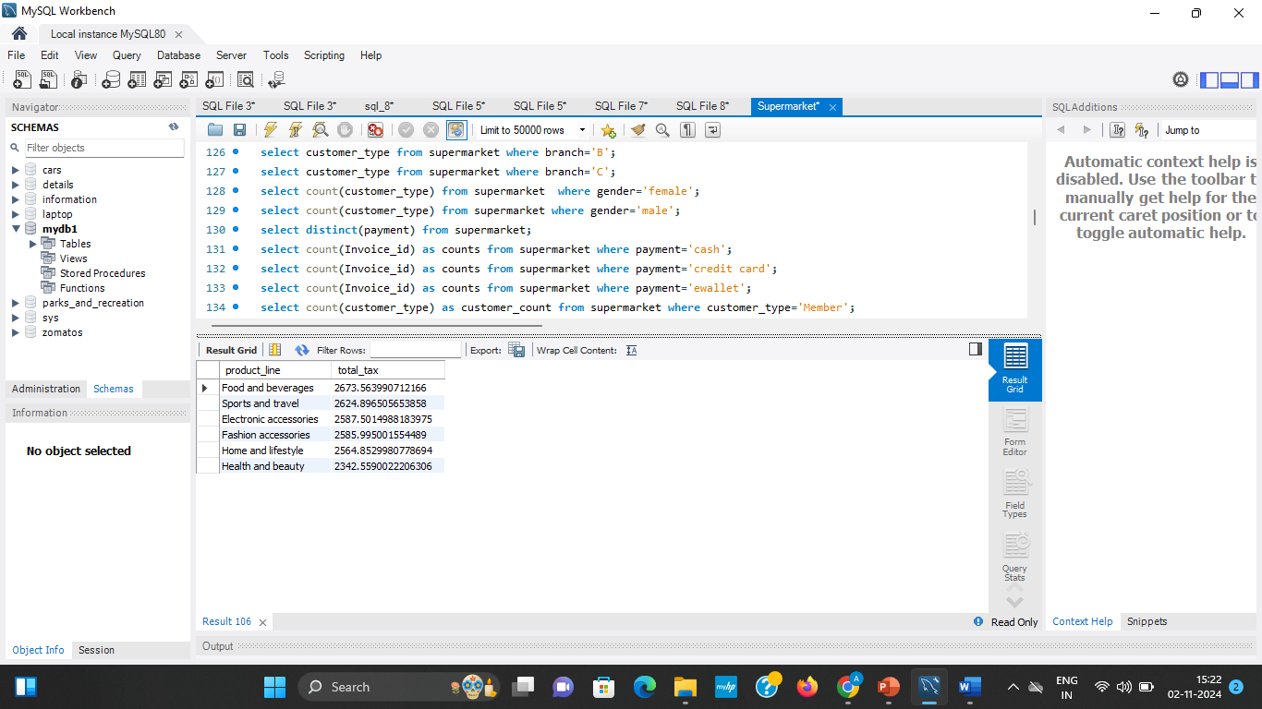
6.What are the types of customer in different branches ?
select customer_type from supermarket where branch=‘A’;
select customer_type from supermarket where branch='B’;
select customer_type from supermarket where branch='C';
7.What are the count of Female, Male customers ?
select count(customer_type) from supermarket where gender='female’;
select count(customer_type) from supermarket where gender='male';
8.Which product line have highest tax ?
select product_line,sum(tax) as total_tax from supermarket group by product_line order by sum(tax) desc;

Slide 13
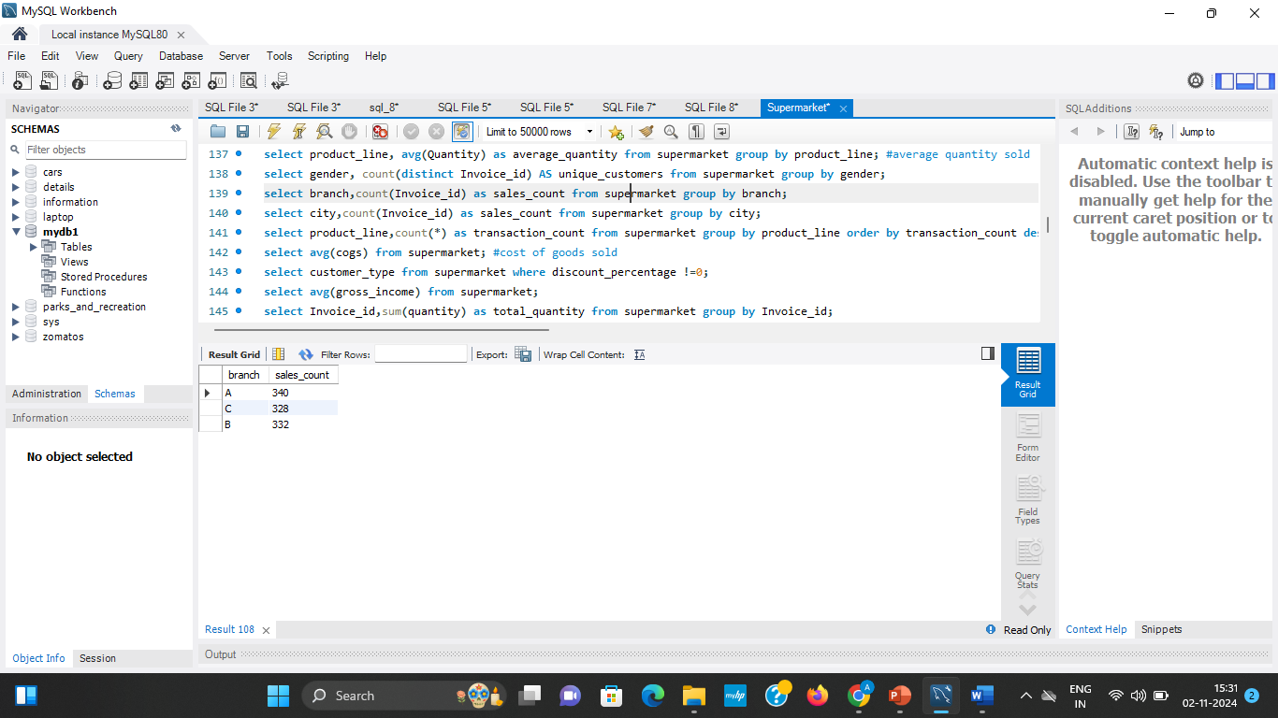
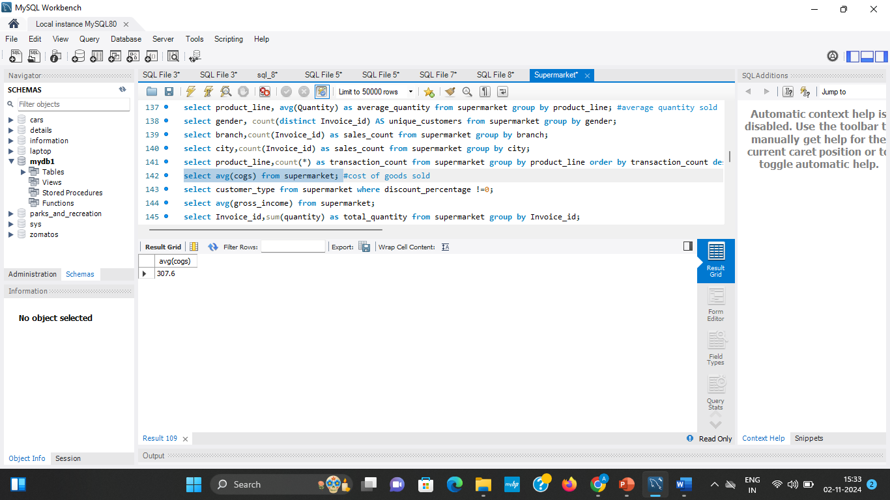
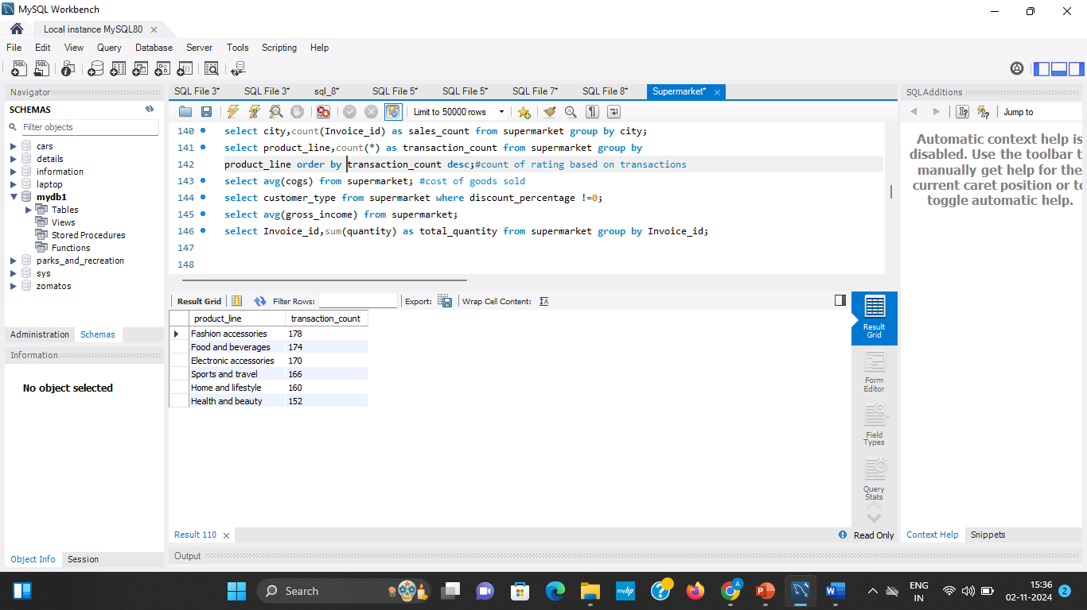
9.What is the sales count based on branches ?
select branch,count(Invoice_id) as sales_count from supermarket group by branch;
10.What is the average of goods sold ?
select avg(cogs) from supermarket;
11.Which product line have highest transaction count ?
select product_line,count(*) as transaction_count from supermarket group by product_line order by transaction_count desc;

Slide 14
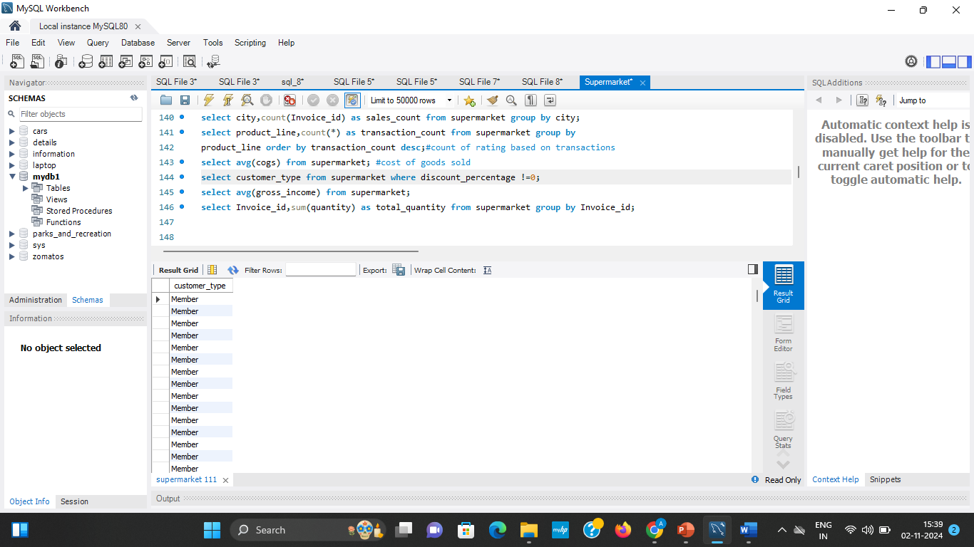
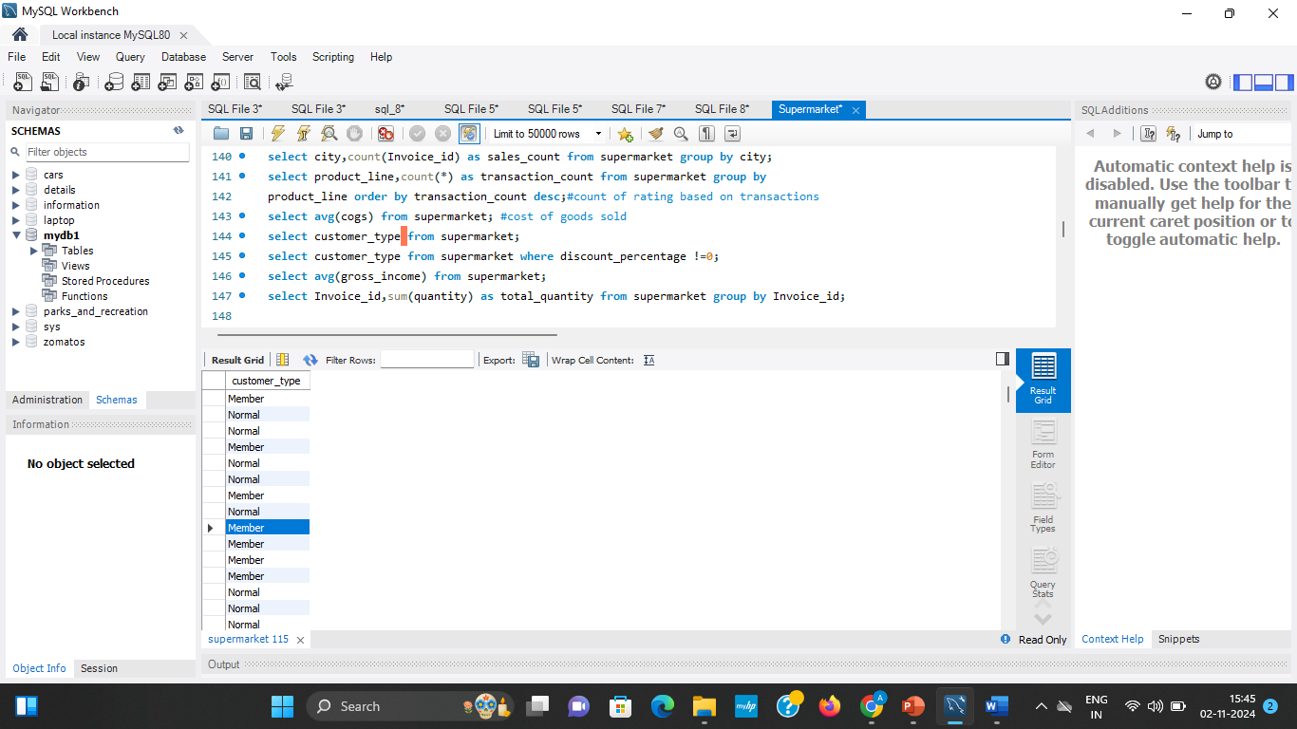
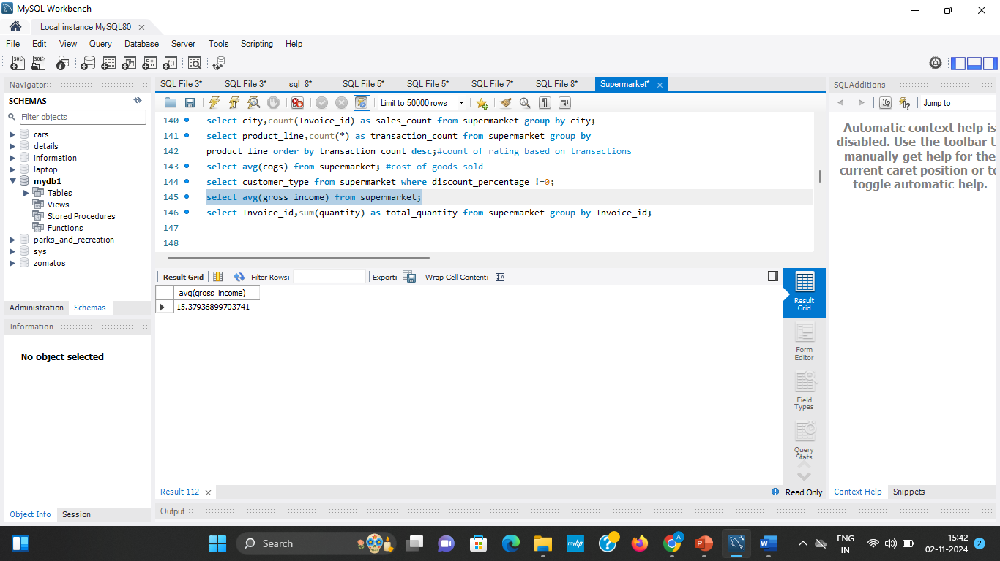
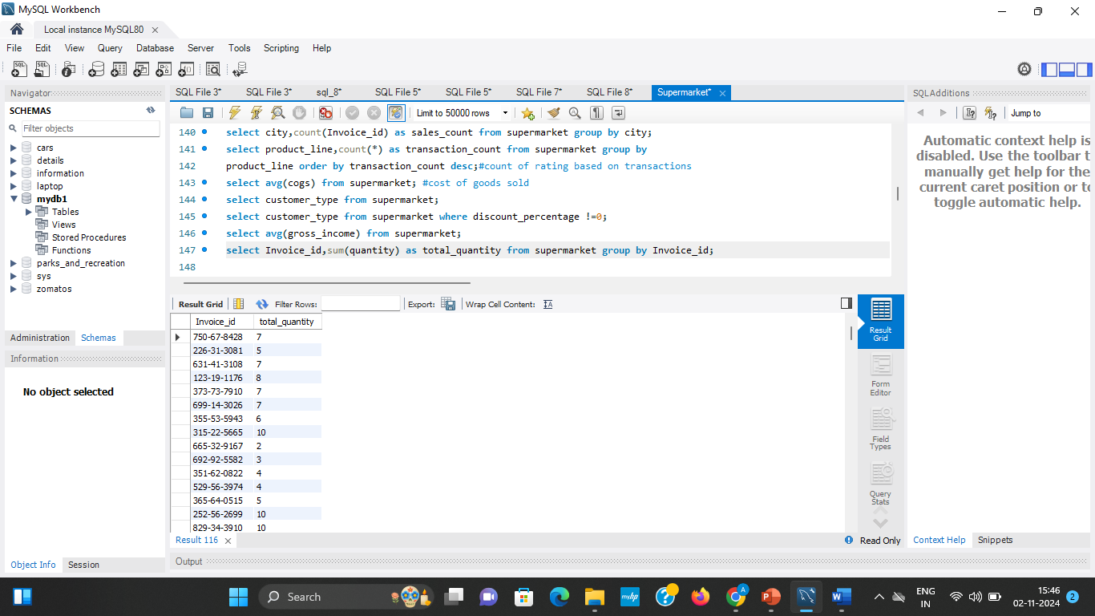
12.Which customer type is given discount ?
select customer_type from supermarket where discount_percentage !=0;
13.What is the count of customer type ?
select customer_type from supermarket;
14.What is the distribution of gross income ?
select avg(gross_income) from supermarket;
15.What is the average number of items per invoice?
select Invoice_id,sum(quantity) as total_quantity from supermarket group by Invoice_id;

Slide 15
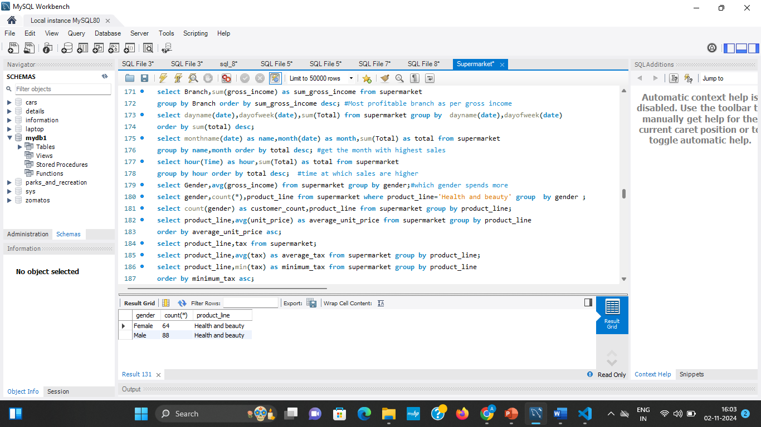
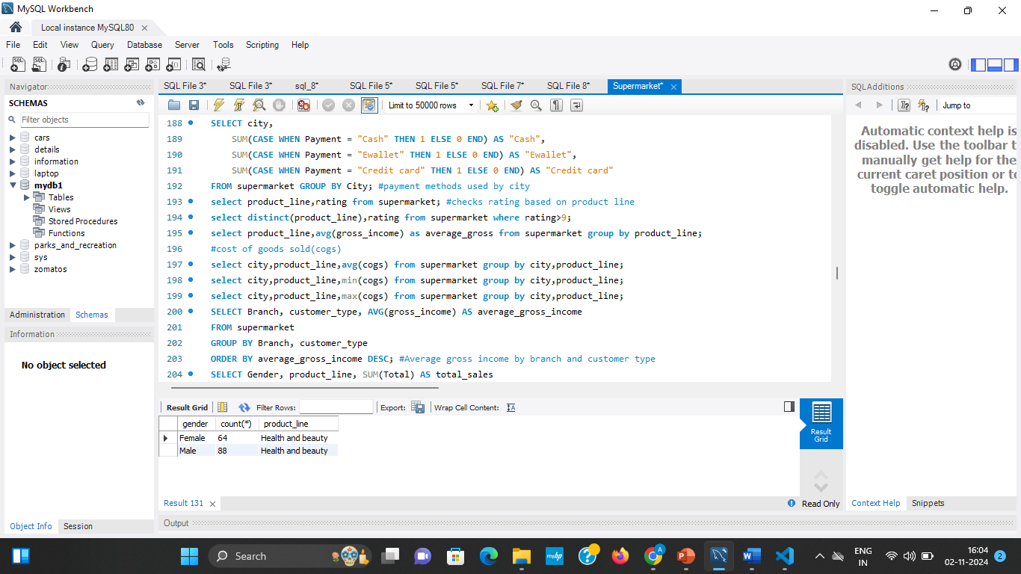
Bivariate Analysis
In a supermarket dataset, bivariate analysis helps explore relationships between two variables, revealing patterns, correlations, or differences that might impact customer behavior, sales trends, or product performance.

Slide 16
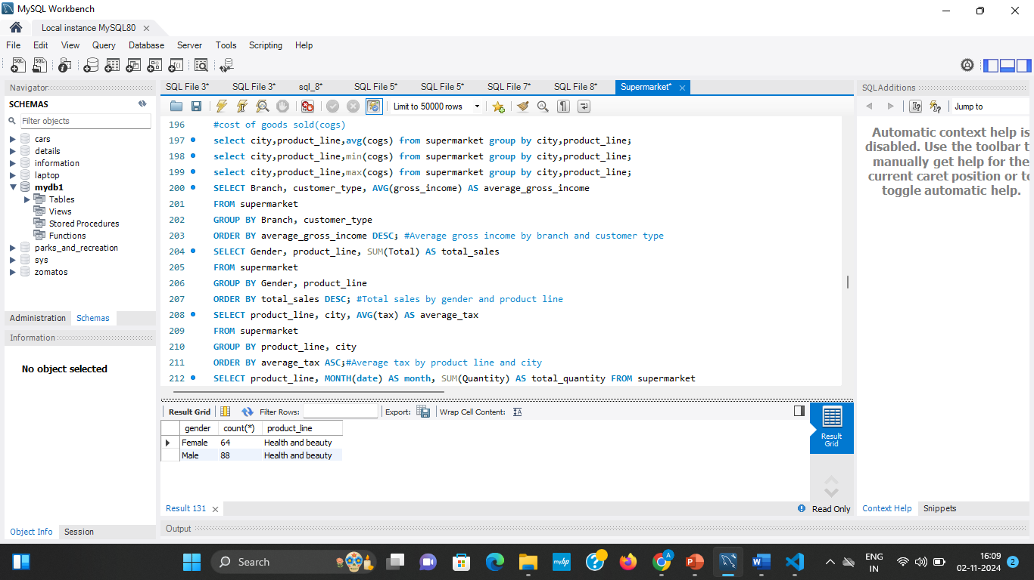
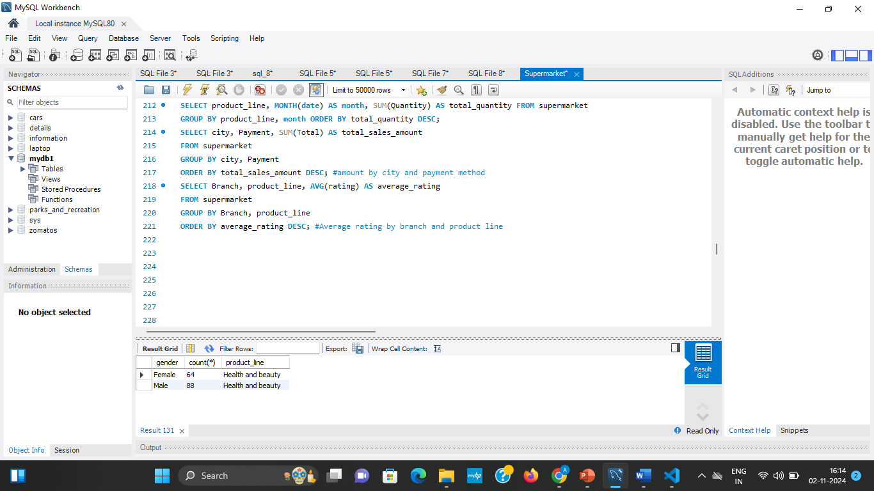

Slide 17
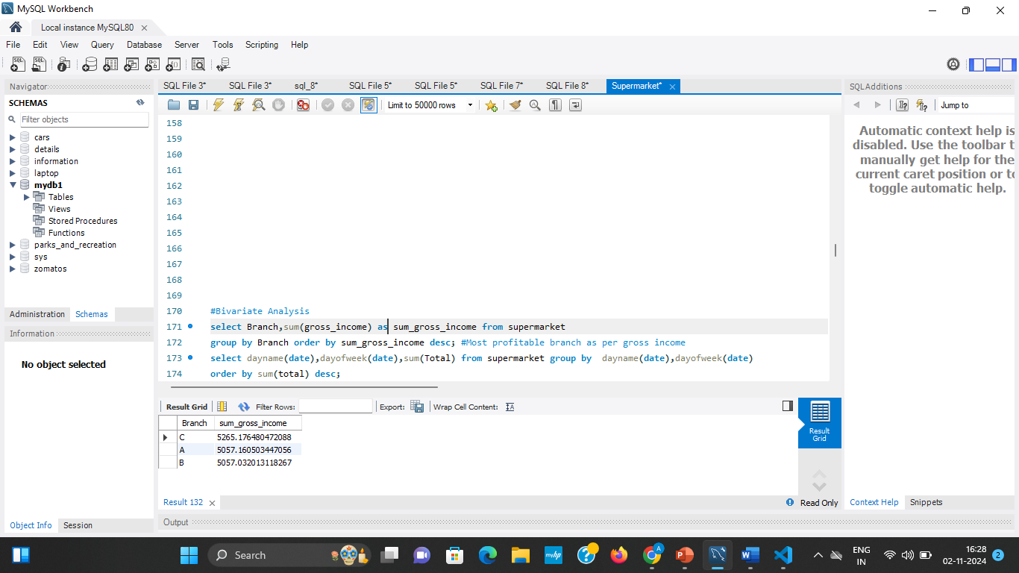
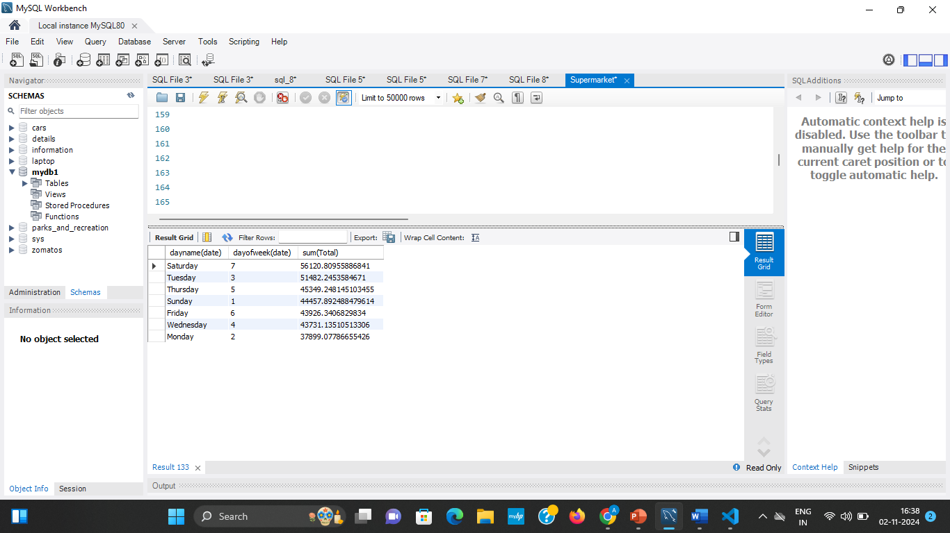
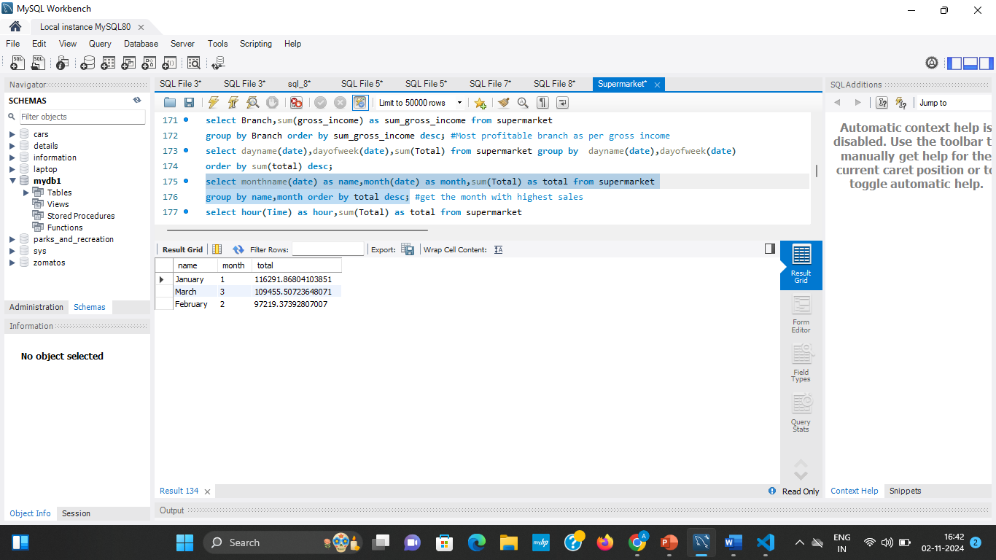
1.Which branch has highest gross Income ?
select Branch,sum(gross_income) as sum_gross_income from supermarket group by Branch order by sum_gross_income desc;
2.Check the total sales based on day name ?
select dayname(date),dayofweek(date),sum(Total) from supermarket group by dayname(date),dayofweek(date)order by sum(total) desc;
3.Check the total sales based on month ?
select monthname(date) as name,month(date) as month,sum(Total) as total from supermarketgroup by name,month order by total desc;

Slide 18
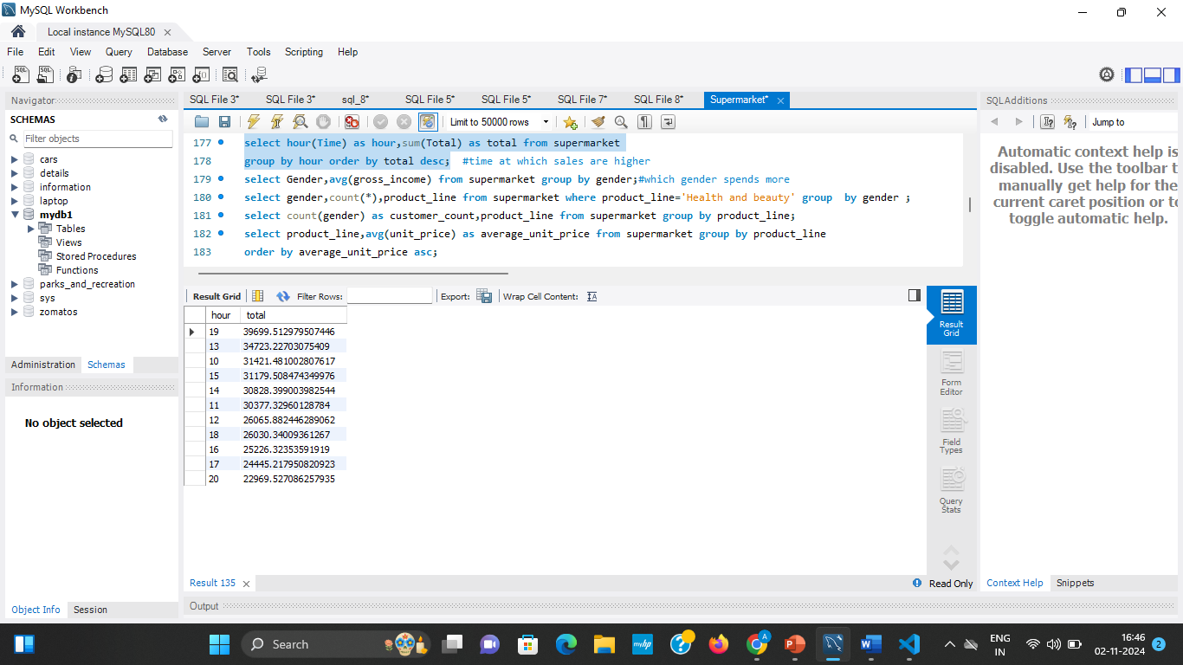
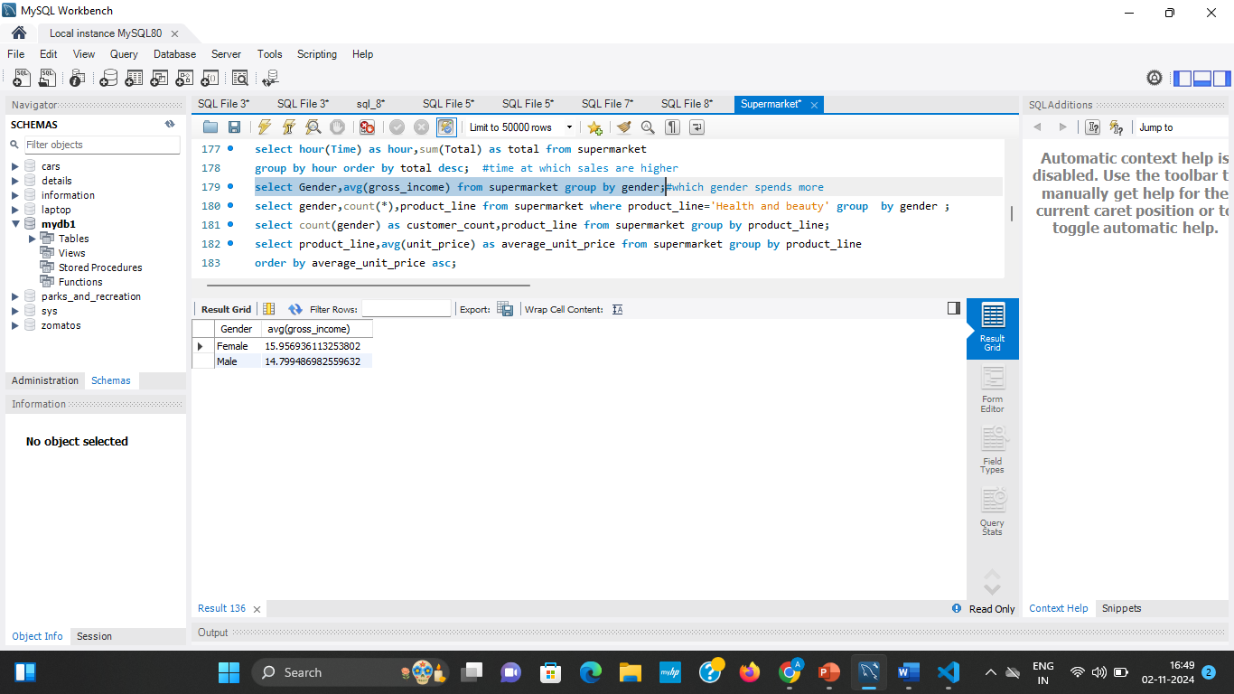
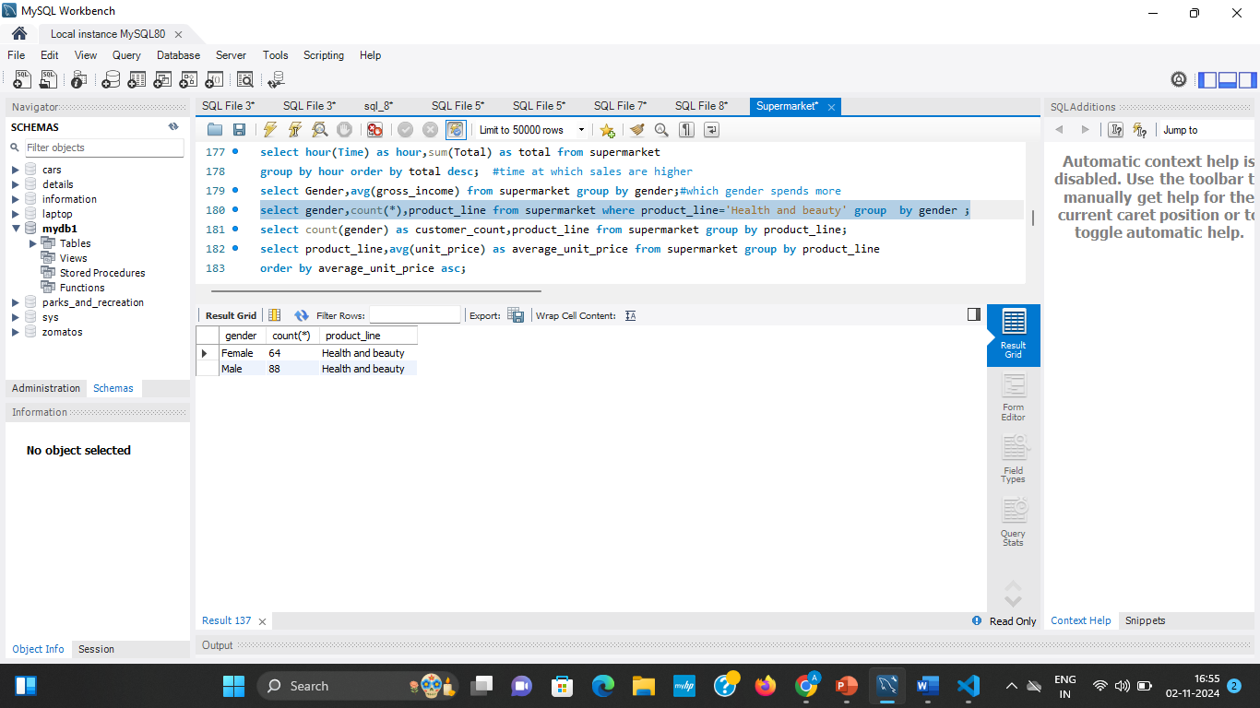
4.Which time highest sales takes place?
select hour(Time) as hour,sum(Total) as total from supermarketgroup by hour order by total desc;
5.Which gender spends more on shopping ?
select Gender,avg(gross_income) from supermarket group by gender;
6. Which gender spends more on health and beauty ?
select gender,count(*),product_line from supermarket where product_line='Health and beauty' group by gender ;

Slide 19
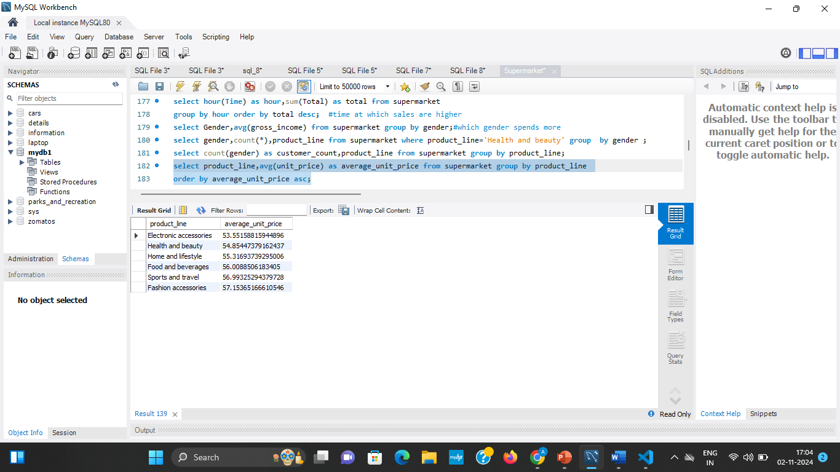
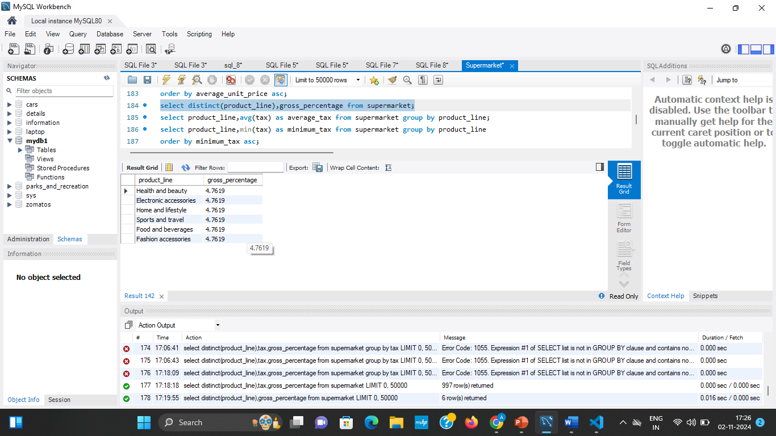
7. What is the average unit price of each product line ?
select product_line,avg(unit_price) as average_unit_price from supermarket group by product_line order by average_unit_price asc;
8.What is the gross percentage based on product line ?
select distinct(product_line),gross_percentage from supermarket;
9.What is the payment mode in different branches ?
SELECT city, SUM(CASE WHEN Payment = "Cash" THEN 1 ELSE 0 END) AS "Cash", SUM(CASE WHEN Payment = "Ewallet" THEN 1 ELSE 0 END) AS "Ewallet", SUM(CASE WHEN Payment = "Credit card" THEN 1 ELSE 0 END) AS "Credit card"FROM supermarket GROUP BY City;

Slide 20
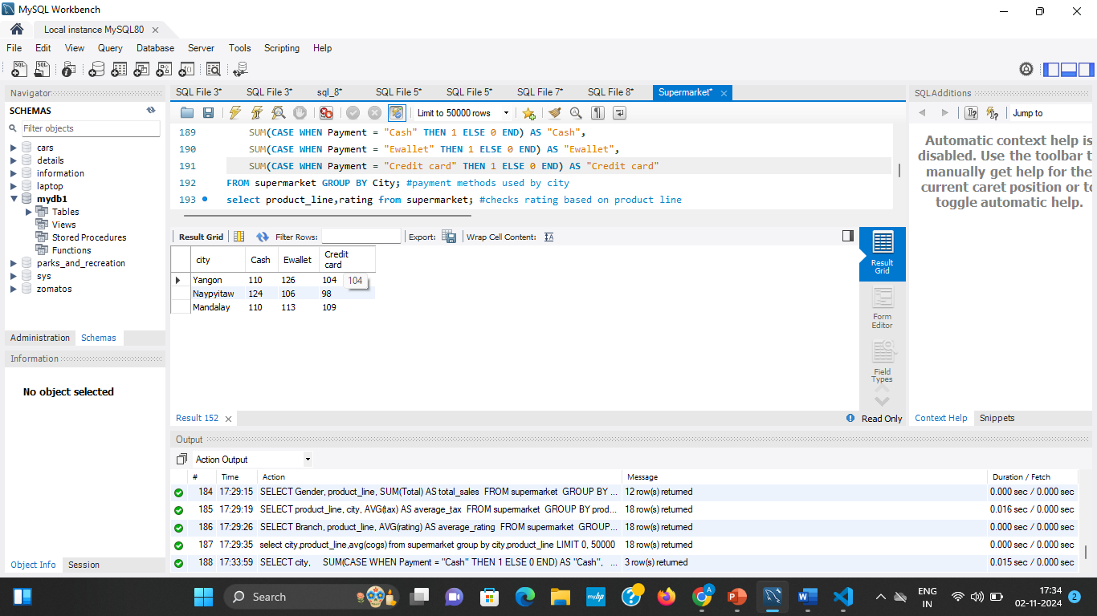
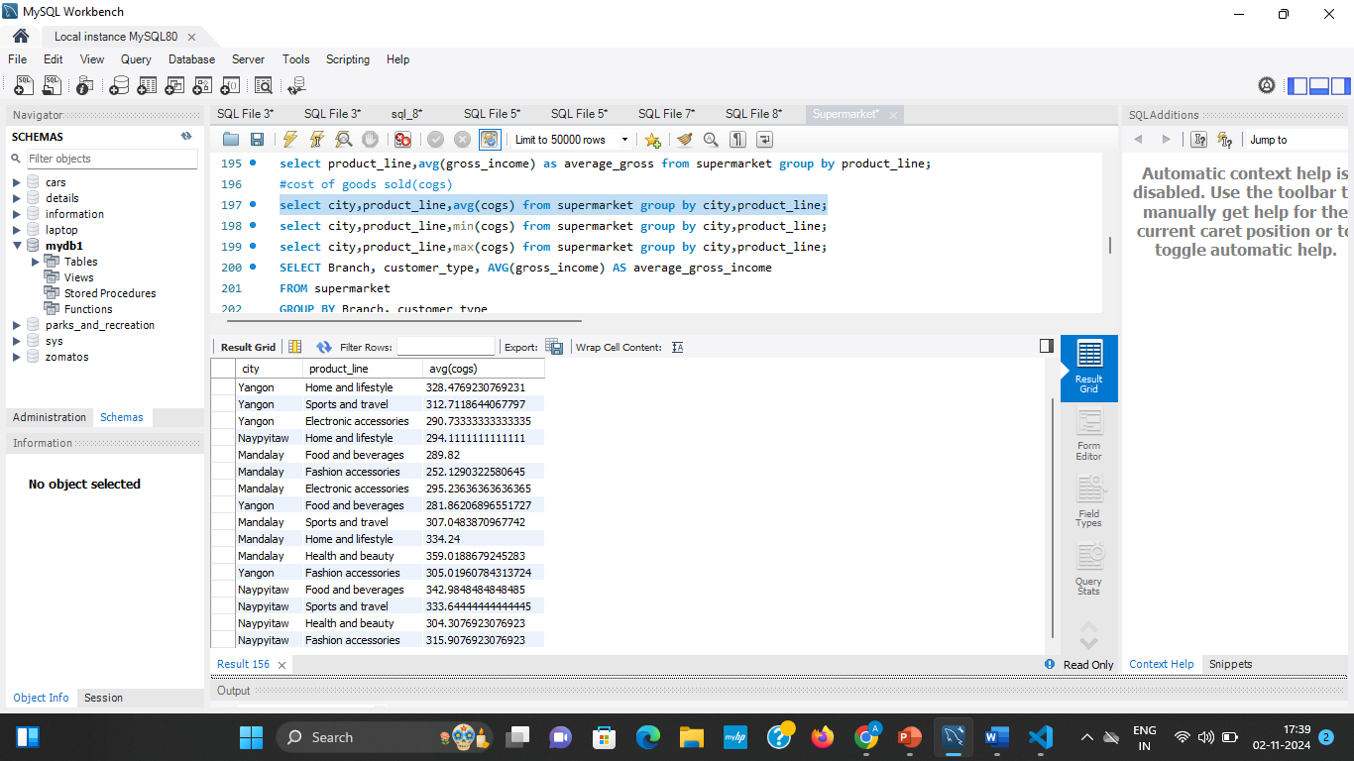
9.What is the average cost of goods sold based on product line and city ?
select city,product_line,avg(cogs) from supermarket group by city,product_line;
10.What is the average income based on customer type ?
SELECT Branch, customer_type, AVG(gross_income) AS average_gross_income FROM supermarket GROUP BY Branch, customer_type ORDER BY average_gross_income DESC;

Slide 21
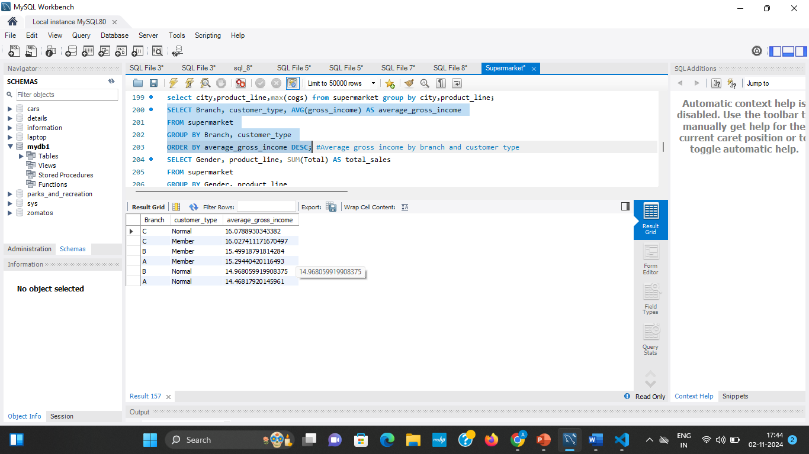
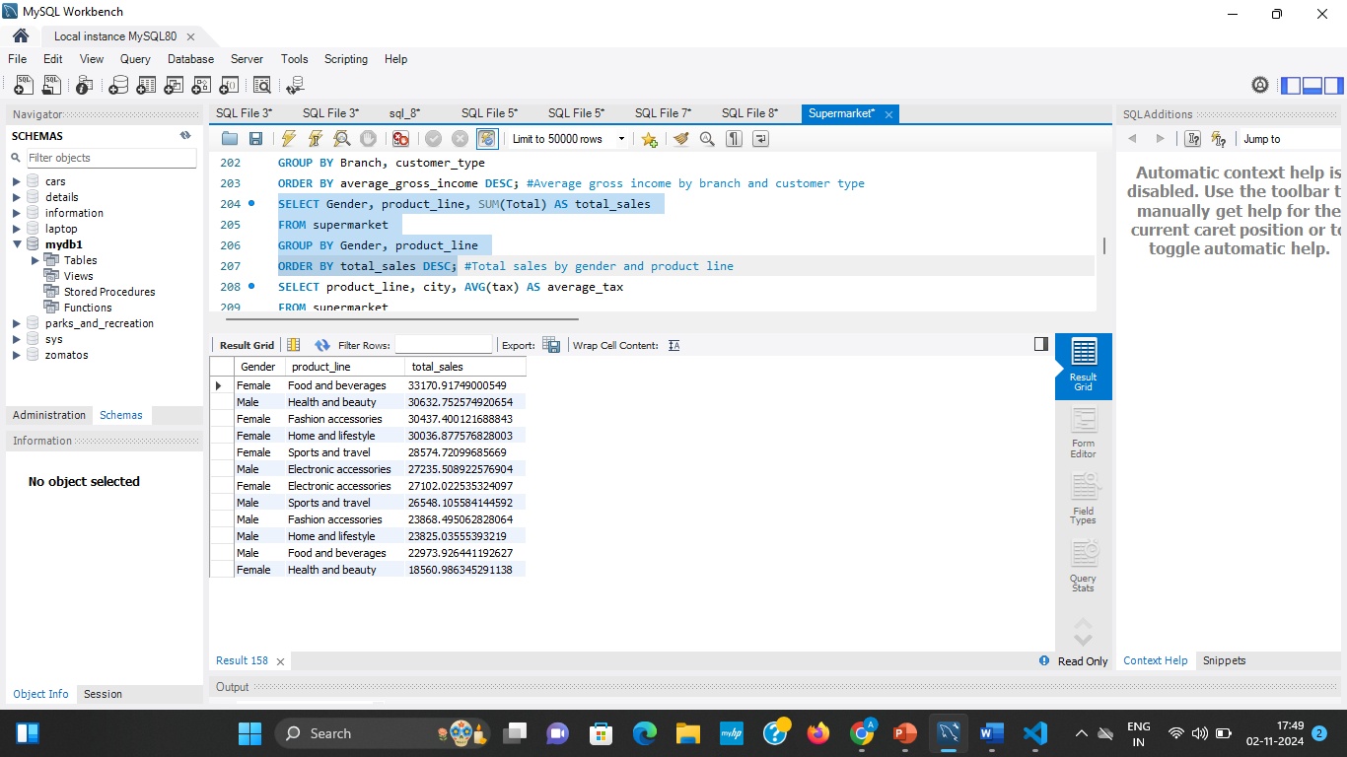
11.What is the total sales based on product line and gender ?
SELECT Gender, product_line, SUM(Total) AS total_sales FROM supermarket GROUP BY Gender, product_line ORDER BY total_sales DESC;
12.What is the product line based tax on each city ?
SELECT product_line, city, AVG(tax) AS average_tax FROM supermarket GROUP BY product_line, city ORDER BY average_tax ASC;

Slide 22
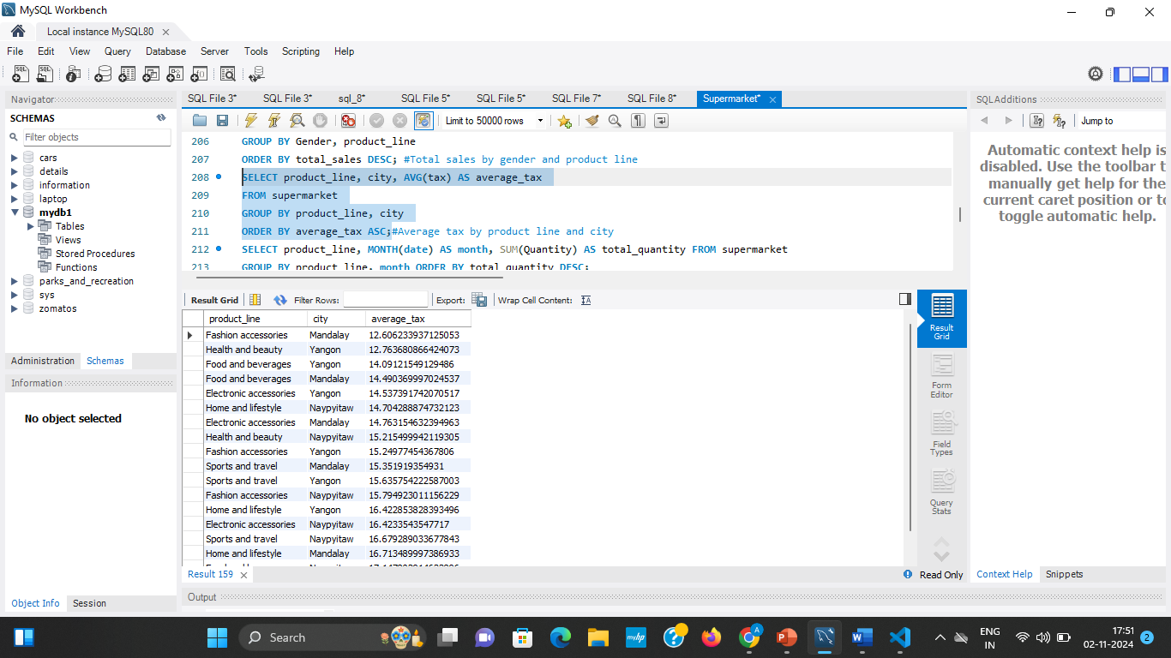
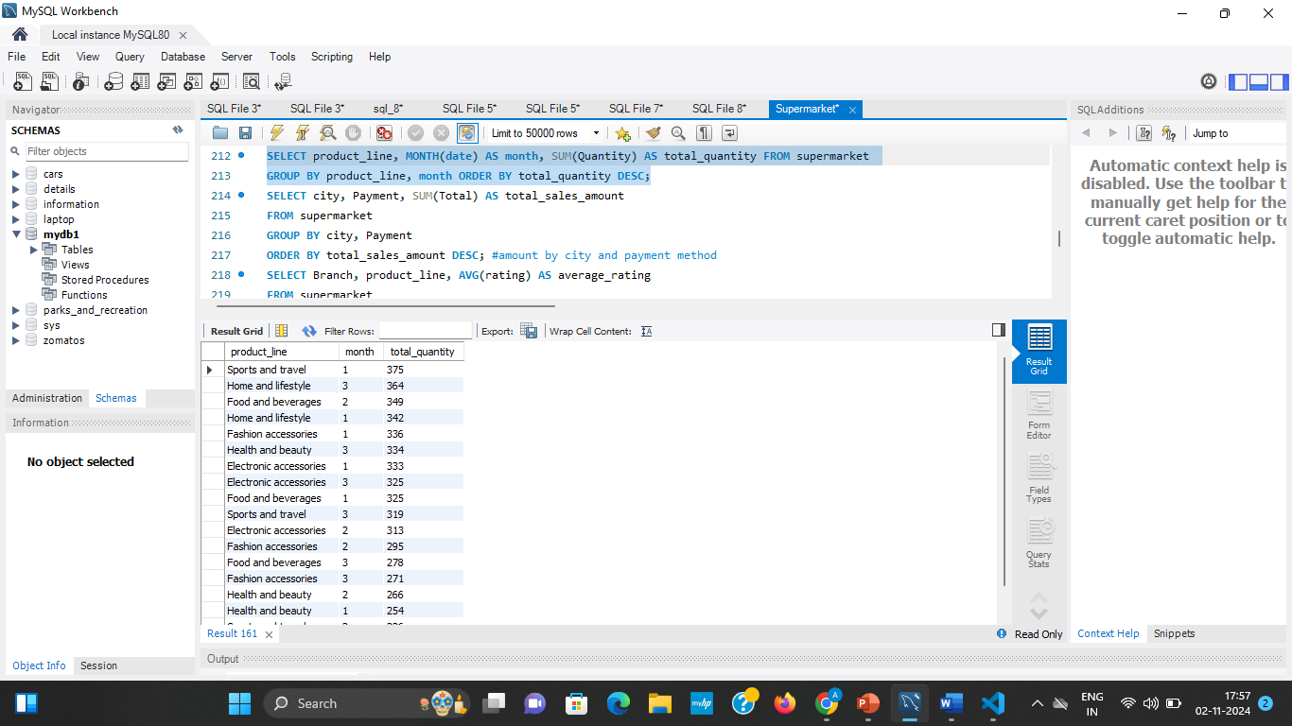
13.What is the quantity of product sold based on month ?
SELECT product_line, MONTH(date) AS month, SUM(Quantity) AS total_quantity FROM supermarket GROUP BY product_line, month ORDER BY total_quantity DESC;

Slide 23
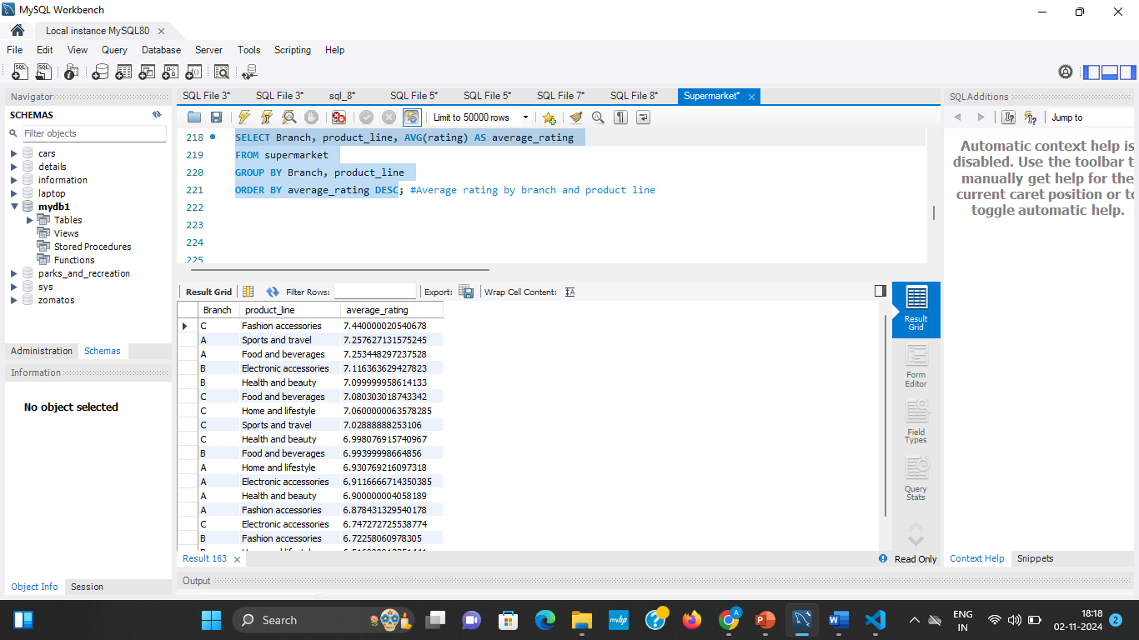
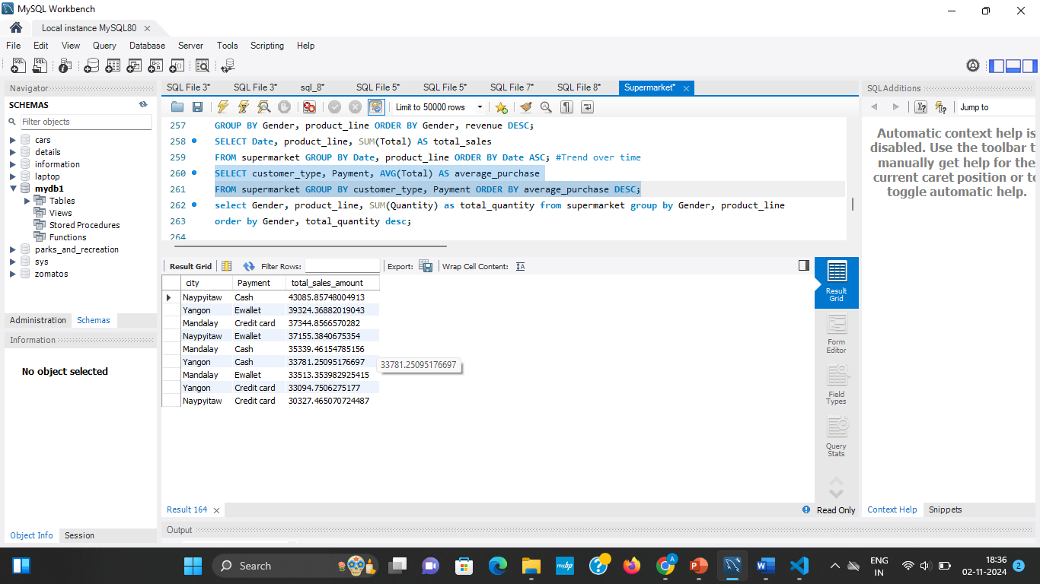
14.What is the product line average rating based on branch?
SELECT Branch, product_line, AVG(rating) AS average_rating FROM supermarket GROUP BY Branch, product_line ORDER BY average_rating DESC;
15.What is the sales amount of sales based on city?
SELECT customer_type, Payment, AVG(Total) AS average_purchaseFROM supermarket GROUP BY customer_type, Payment ORDER BY average_purchase DESC;

Slide 24
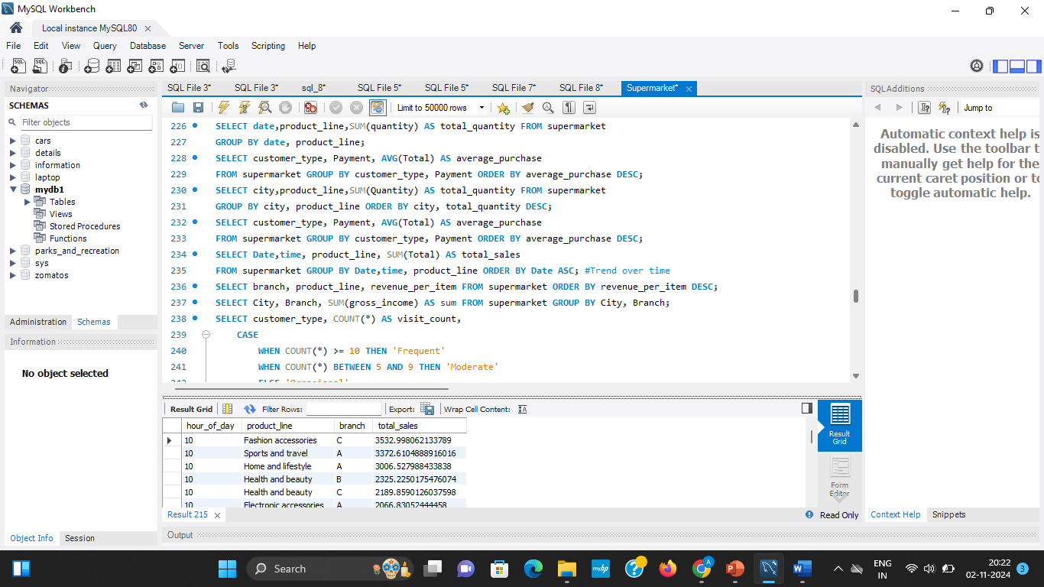
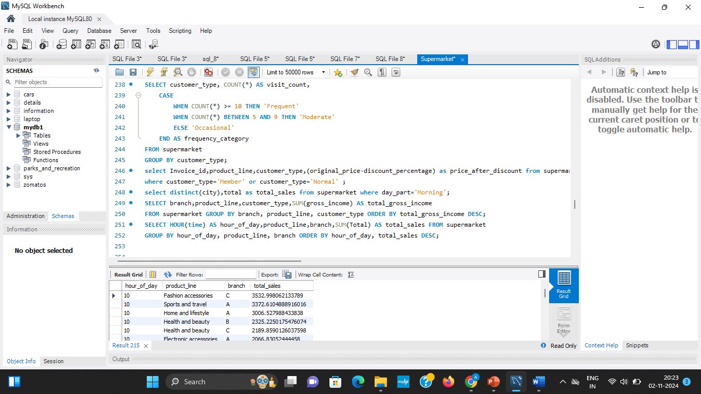
Multivariate Analysis
Multivariate analysis in the context of supermarket sales involves examining the relationships between three or more variables simultaneously to understand how they interact and influence sales performance.

Slide 25
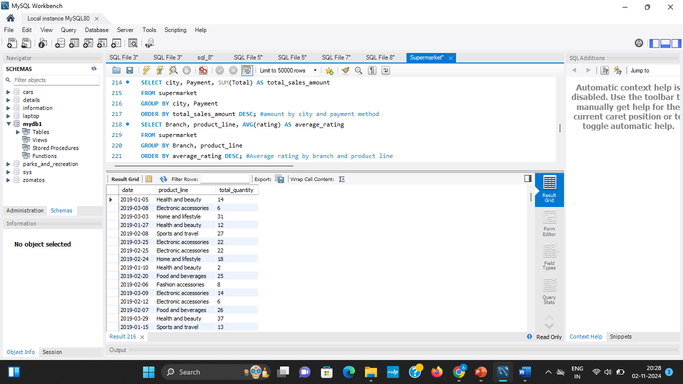
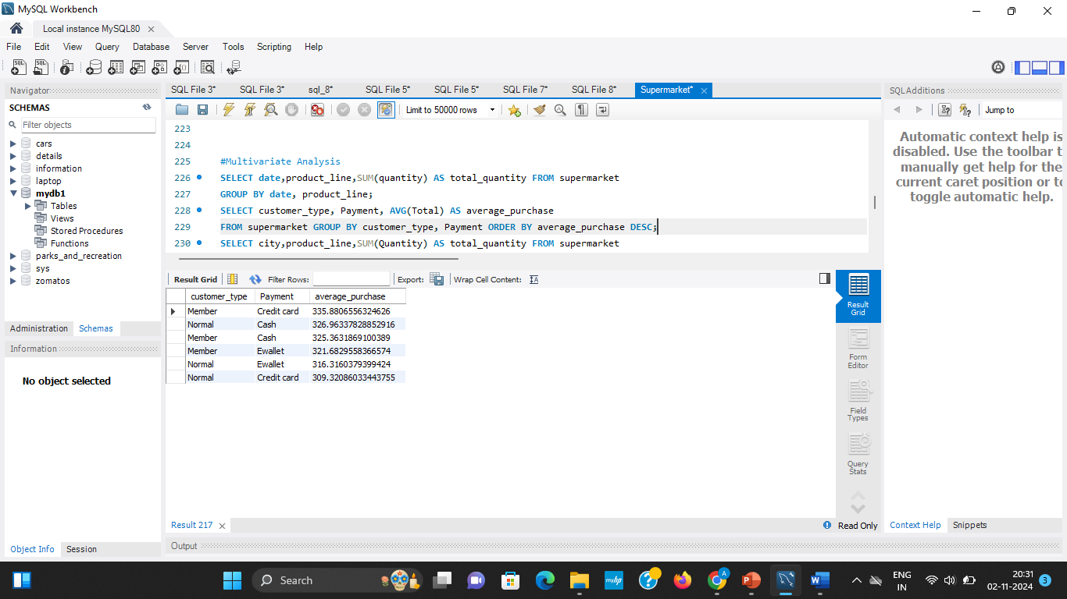
1.What is the total quantity sold based on date for each product line ?
SELECT date,product_line,SUM(quantity) AS total_quantity FROM supermarket GROUP BY date, product_line;
2.What is the average sales by customer based on payment ?
SELECT customer_type, Payment, AVG(Total) AS average_purchaseFROM supermarket GROUP BY customer_type, Payment ORDER BY average_purchase DESC;

Slide 26
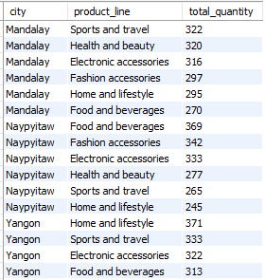
3.What is the total quantity of each product line sold in each city, and how does this quantity vary by city?
SELECT city,product_line,SUM(Quantity) AS total_quantity FROM supermarket GROUP BY city, product_line ORDER BY city, total_quantity DESC;
4.What is the average purchase amount for each customer type based on different payment methods, and which combinations lead to the highest average purchase?
SELECT customer_type, Payment, AVG(Total) AS average_purchaseFROM supermarket GROUP BY customer_type, Payment ORDER BY average_purchase DESC;

Slide 27
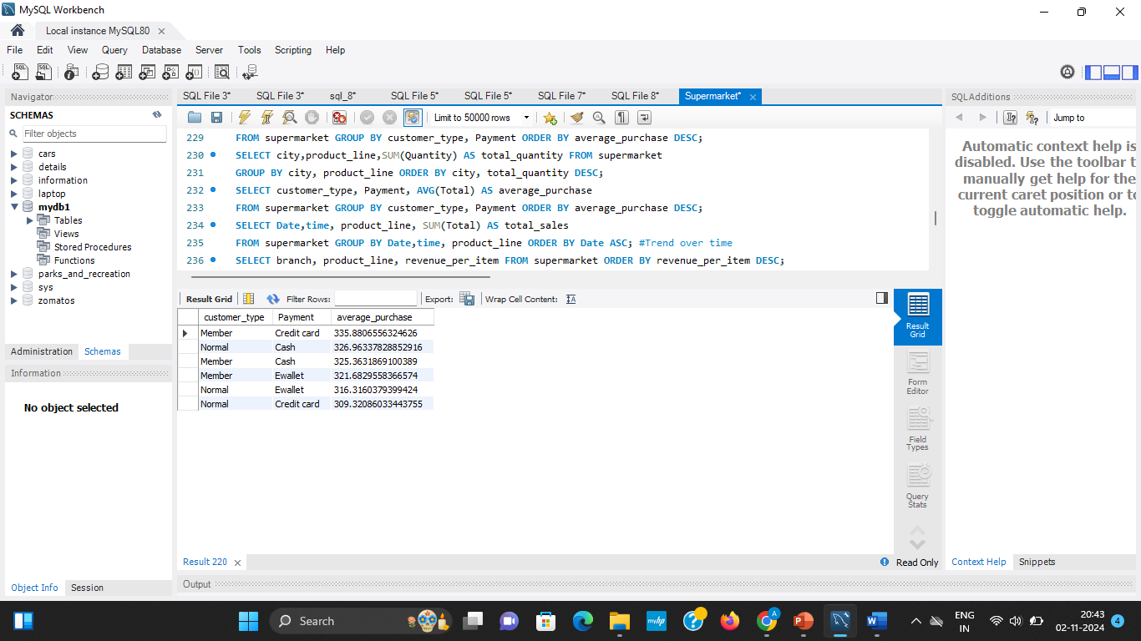
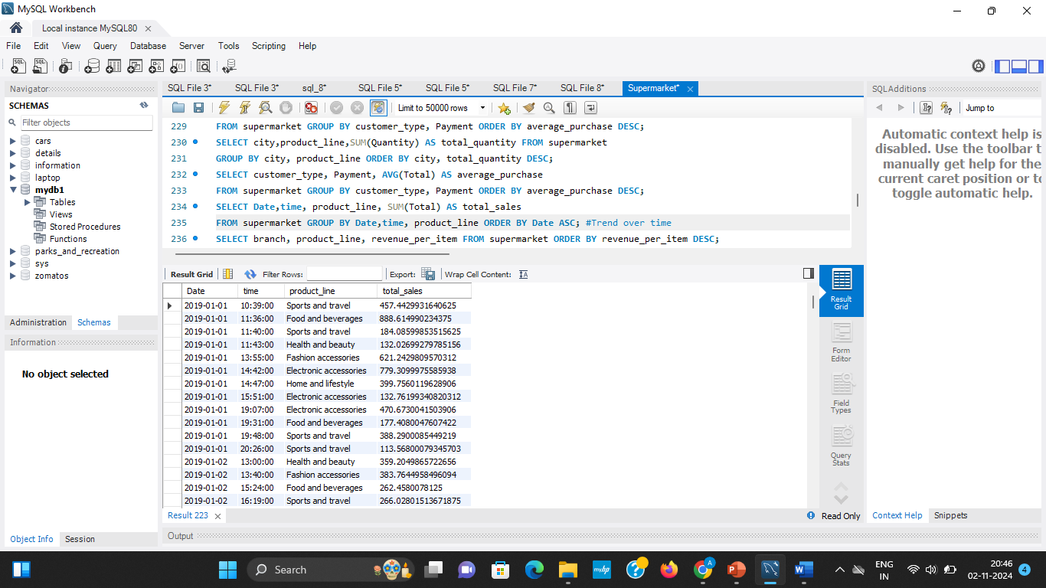
5.What are the total sales for each product line at different times throughout each day, and how do these sales trends vary over time ?
SELECT Date,time, product_line, SUM(Total) AS total_salesFROM supermarket GROUP BY Date,time, product_line ORDER BY Date ASC;
6. Which product lines generate the highest revenue per item in each branch, and how do branches compare in terms of high-revenue items?
SELECT branch, product_line, revenue_per_item FROM supermarket ORDER BY revenue_per_item DESC;

Slide 28


7. What is the total gross income generated by each branch in each city ?
SELECT City, Branch, SUM(gross_income) AS sum FROM supermarket GROUP BY City, Branch;

Slide 29


8.How frequently do different types of customers visit, and how can they be categorized based on their visit frequency?
SELECT customer_type, COUNT(*) AS visit_count, CASE WHEN COUNT(*) >= 10 THEN 'Frequent' WHEN COUNT(*) BETWEEN 5 AND 9 THEN 'Moderate' ELSE 'Occasional' END AS frequency_category FROM supermarket GROUP BY customer_type;
9.What is the final price after discounts for each product line, based on customer type (Member or Normal)?
select Invoice_id,product_line,customer_type,(original_price-discount_percentage) as price_after_discount from supermarketwhere customer_type='Member' or customer_type='Normal' ;

Slide 30


10. What are the total sales in different cities during the morning period?
select distinct(city),total as total_sales from supermarket where day_part='Morning';
11. Which branches generate the highest total gross income from different product lines for each customer type?
SELECT branch,product_line,customer_type,SUM(gross_income) AS total_gross_income FROM supermarket GROUP BY branch, product_line, customer_type ORDER BY total_gross_income DESC;

Slide 31

12.What are the total sales for each product line across different branches, broken down by hour of the day?
SELECT HOUR(time) AS hour_of_day,product_line,branch,SUM(Total) AS total_sales FROM supermarket GROUP BY hour_of_day, product_line, branch ORDER BY hour_of_day, total_sales DESC;

Slide 32

Count Plot
The Fashion accessories have highest count which is 175.
The health and beauty have lowest count which is 150.

Slide 33

The count for the payment done through E wallet is between the range 300-350.
The count for the payment done trough Cash Payment is between the range 300-350 but less than the payment done through E-wallet.
The count for the payment done trough Credit Payment is between the range 300-320 but less than the payment done through E-wallet and Cash payment.

Slide 34

The count for the payment done through E wallet, Cash Payment and Credit card in different Branches A,B,C of the super market is represented above through count plot .
The Branch A has highest payment customer through E wallet.
The Branch C has highest payment customer through cash payment.
The Branch B has highest payment customer through credit card.

Slide 35



Slide 36

Bar Plot
The Member of the super market who has membership is purchased more than 150000.
The Member of the super market who has membership is purchased almost around 150000.

Slide 37

Line Plot
This line plot represents the quantity of products got sales per hour.

Slide 38
CONCLUSION
The super market is present in cities named Yangon, Naypyitaw, Mandalay which has branch named as A,B,C
Mostly the payment is done through E wallet.
The highest rating for the product line is Food and beverages and the less rating is for home and life style.
The highest quantity of the sales takes place in product line electronic accessories and lowest quantity of the sales takes place in product line health and beauty.
The membership customer is known as member and has 10% discount for purchasing products.
Food and beverages has highest tax and Health and beauty has lowest tax
The super market located at the city Yangon has highest tax.
More sales takes place between the time between Morning 10 AM and Night 8 PM.
During January, February, March most amount of sales takes place.
The female customers done more purchase than male customers.
The highest cost of goods sold for product line fashion accessories is in the city Naypyitaw.

Slide 39
THANK YOU

